Slide 1

Breast Cancer Detection
Yashwanth

Slide 2
Problem Statement:
Breast cancer is one of the most common types of cancer among women. The Wisconsin Breast cancer detection dataset has different computed measures of cells/tumors and label diagnosis. The objective is to based on the cell measures we need to identify whether the tumor/cell is malignant or non-malignant(benign)

Slide 3
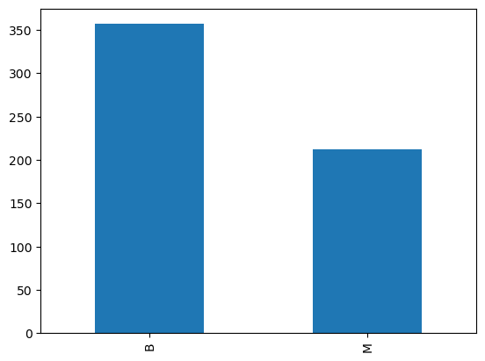
Data Exploration
Total of 569 Records out of them 212 are Malignant
There are a total of 32 attributes:
Id a unique Identifier.
Diagnosis- Used as Label.
30 Features define a measure of cell/tumor.
1-10 – Mean Measure Features
11-20- Standard Error Measures
21-30 – Worst Cell Measures.

Slide 4
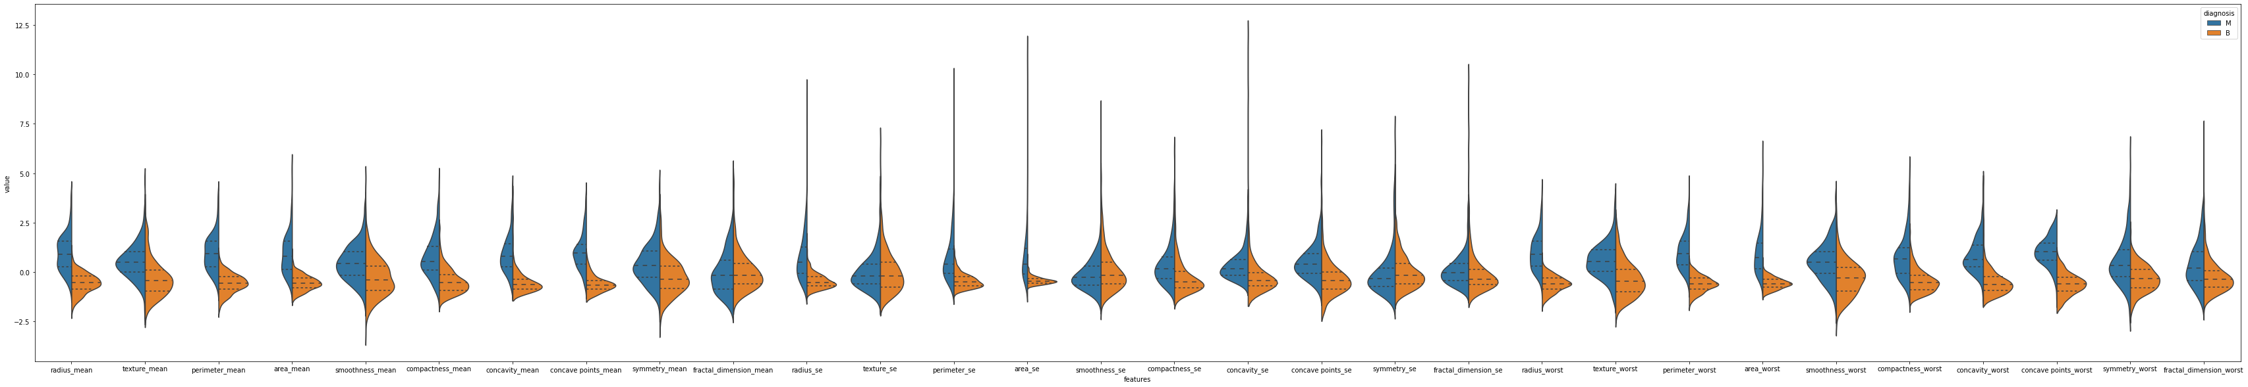
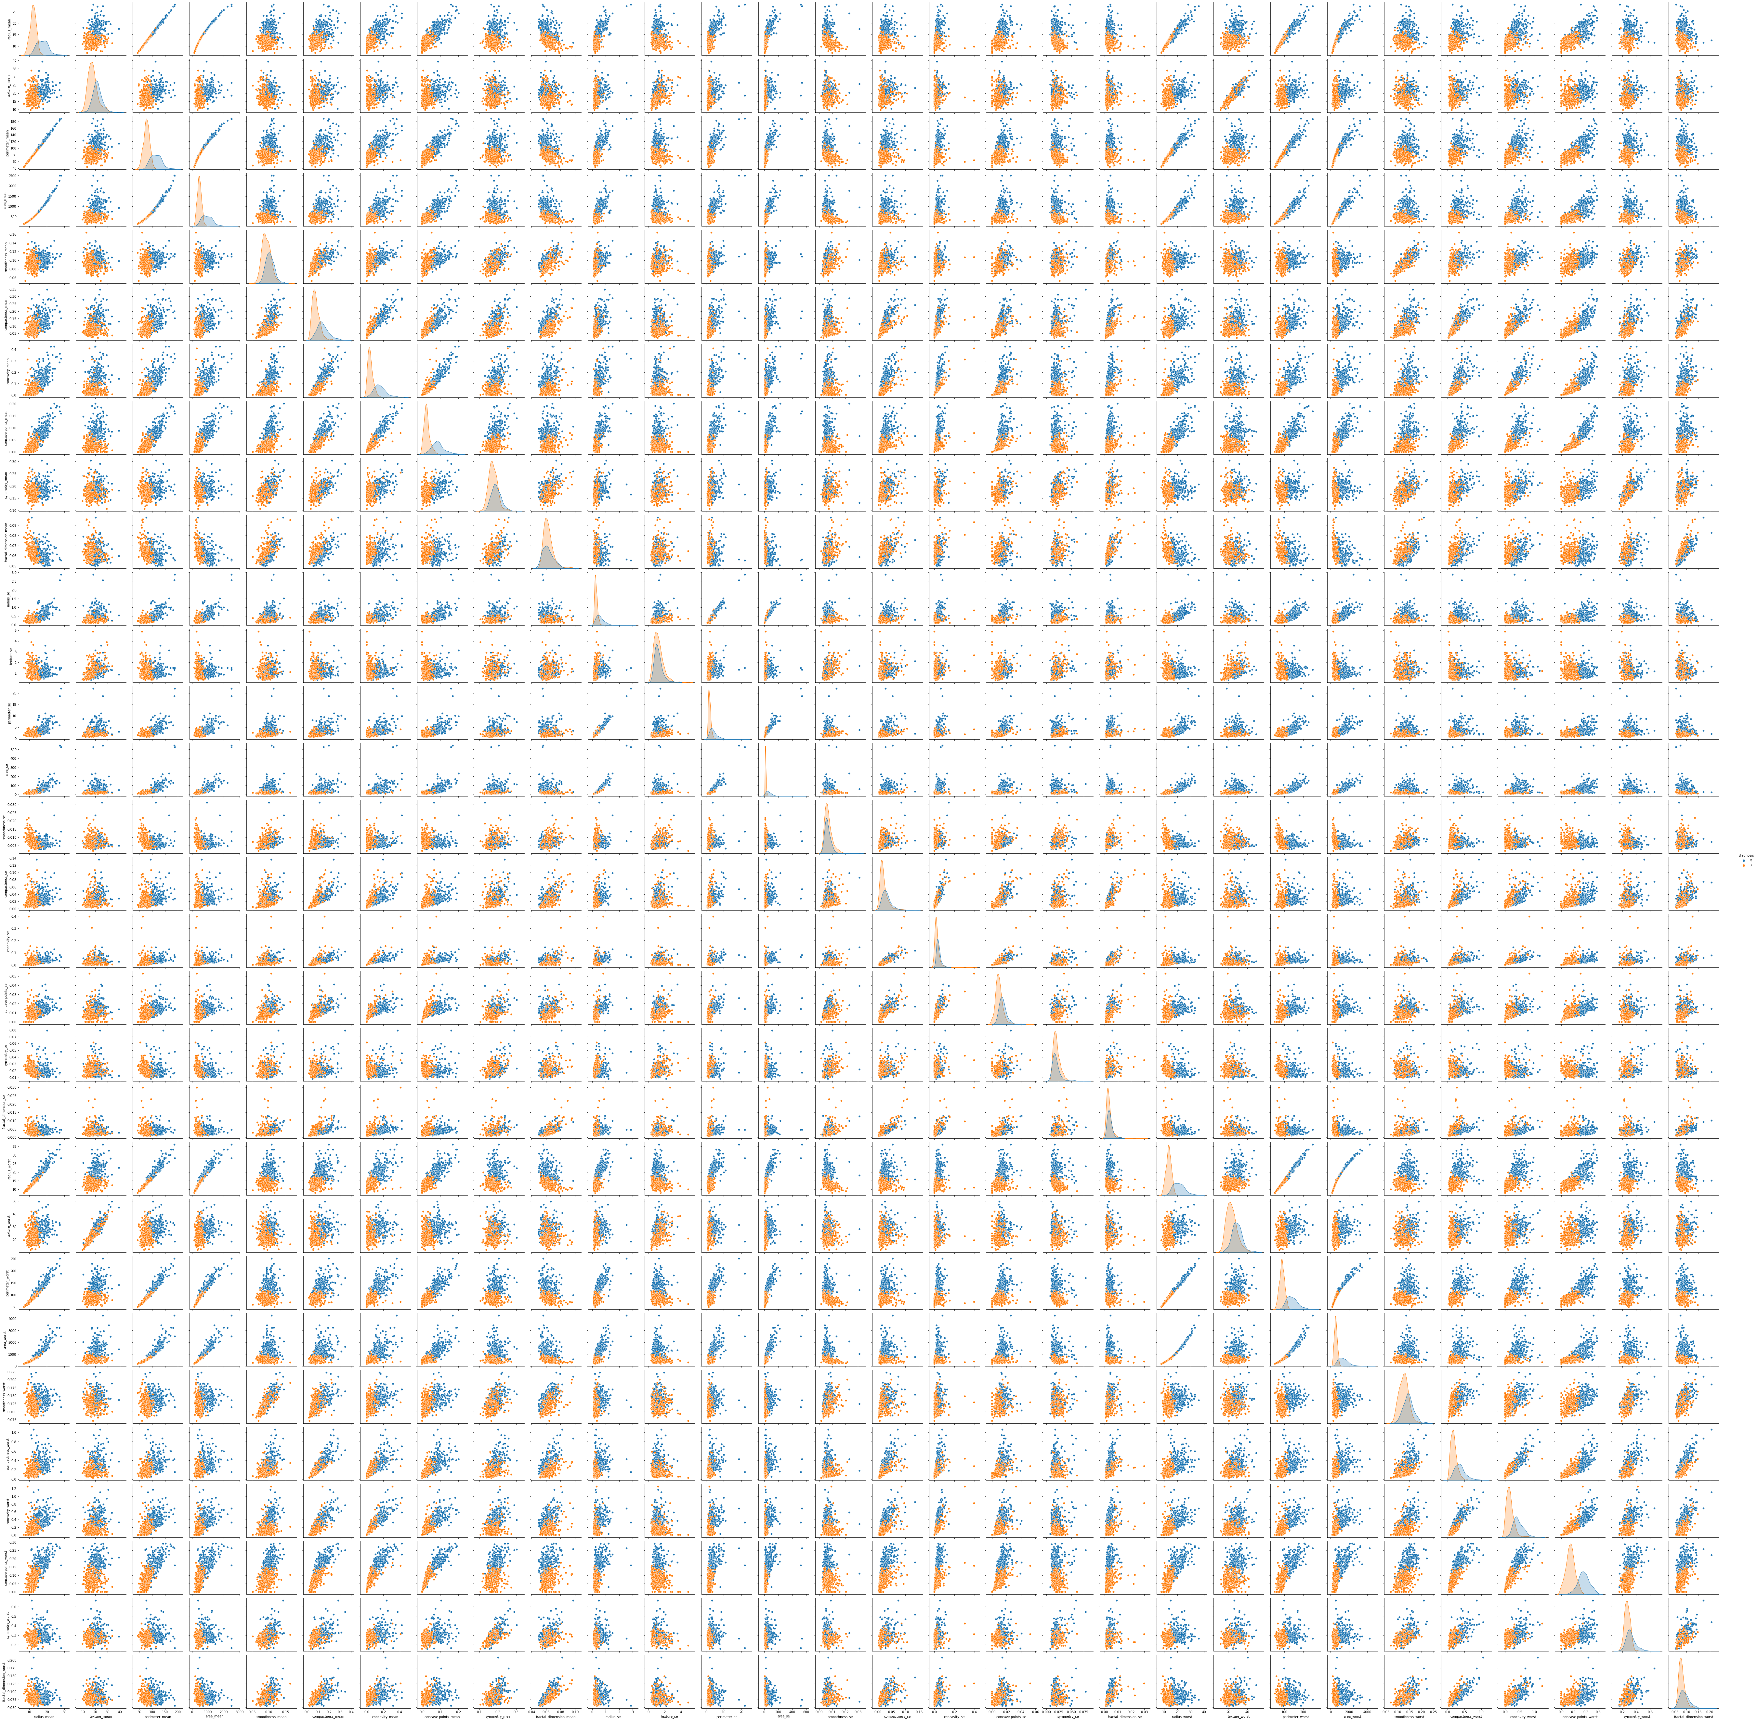
When checking the distribution of the spread of each feature. It was found that the mean value of malignant rows is higher compared to non-malignant rows. This was observed in almost all features.
When pair plots were plotted, it is observed that the malignant and non-malignant are clustered and easily identified with a slight overlap.

Slide 5
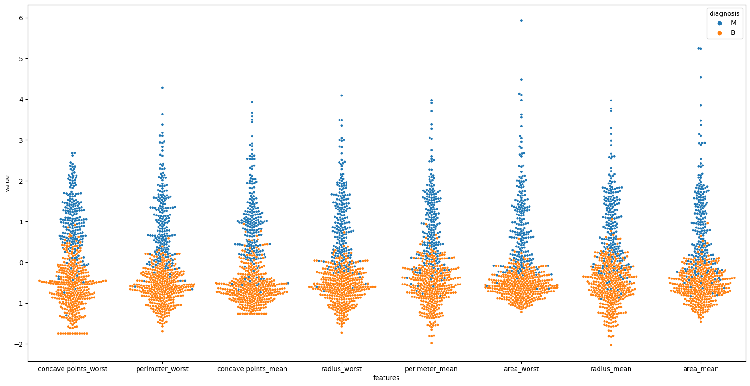
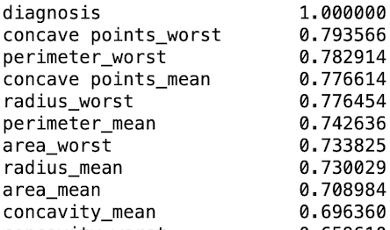
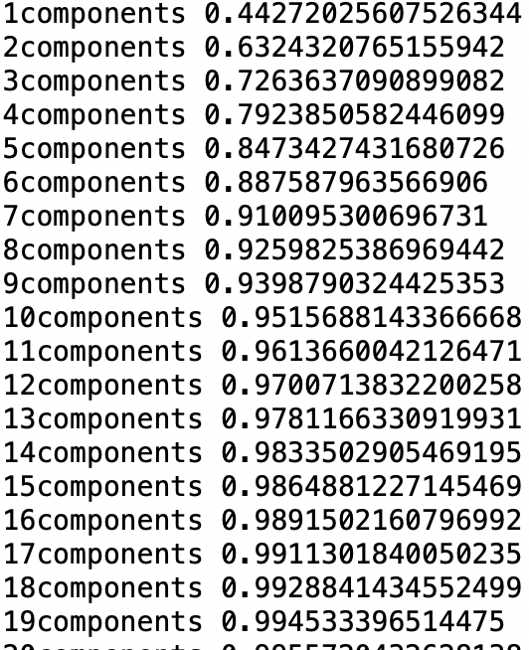
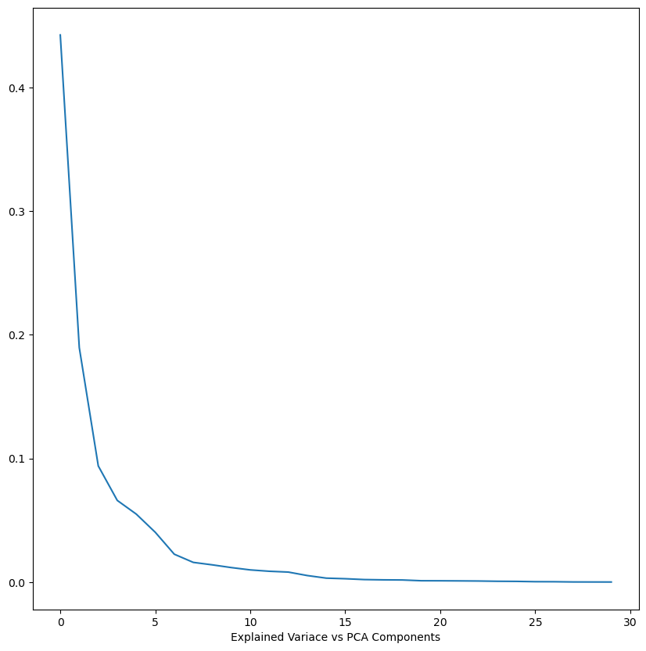
Most of the features are positively co-related. When a swarm plot is plotted it is very clear evidence that the l
linear model will be very easily able to classify the data
When Principal Component Analysis performed on features its observed 15 components are needed to achieve the cumilative of 98% Explained Variance.

Slide 6
Modeling:
Feature Engineering:
Standardizer Standardizer + SMOTE (Over Sampling)
Experimenting Models
Model | TP | TN | FP | FN | F1 Score
Logistic | 53 | 86 | 3 | 1 | 96.3
Logistic +SMOTE | 53 | 86 | 3 | 1 | 96.3
SVM | 52 | 88 | 1 | 2 | 97.1
SVM + SMOTE | 52 | 88 | 1 | 2 | 97.1
DT | 50 | 86 | 3 | 4 | 93
DT +SMOTE | 51 | 82 | 7 | 3 | 91
Random Forest | 50 | 88 | 1 | 3 | 96.2
RF + SMOTE | 51 | 88 | 1 | 3 | 96.2
ANN | 53 | 88 | 1 | 1 | 98.1
From the above results, I would Select the SVM model as the final model over all other models.
Even though ANN has a better F1 Score but the neural networks are computationally expensive and tend to overfit.
There is no significant improvement in the model with oversampling.
The logistic Regression Model has very less False negative’s but model looks like overfit as f1 score on train set is more

Slide 7
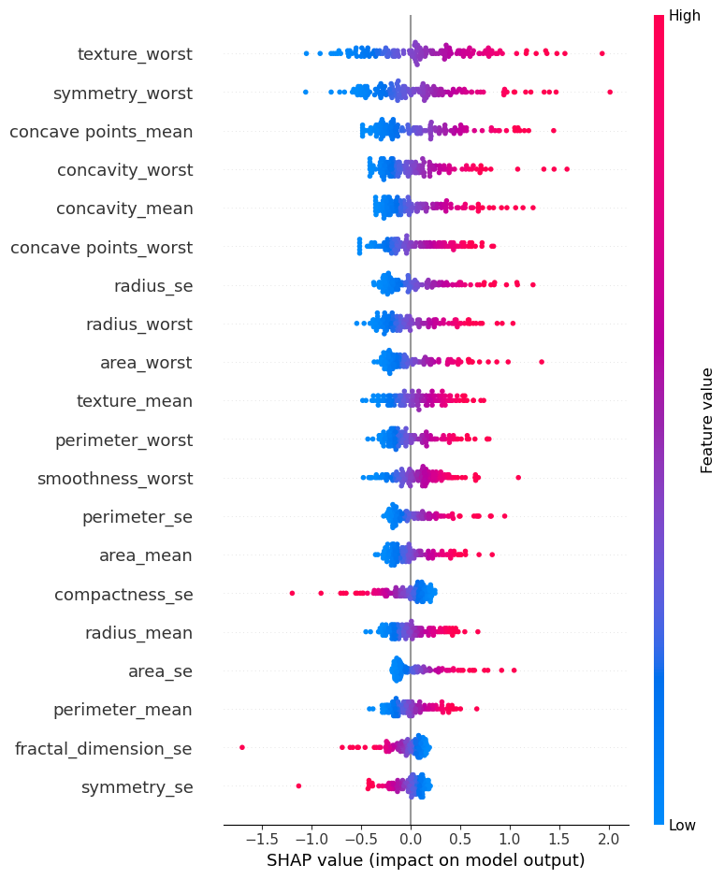
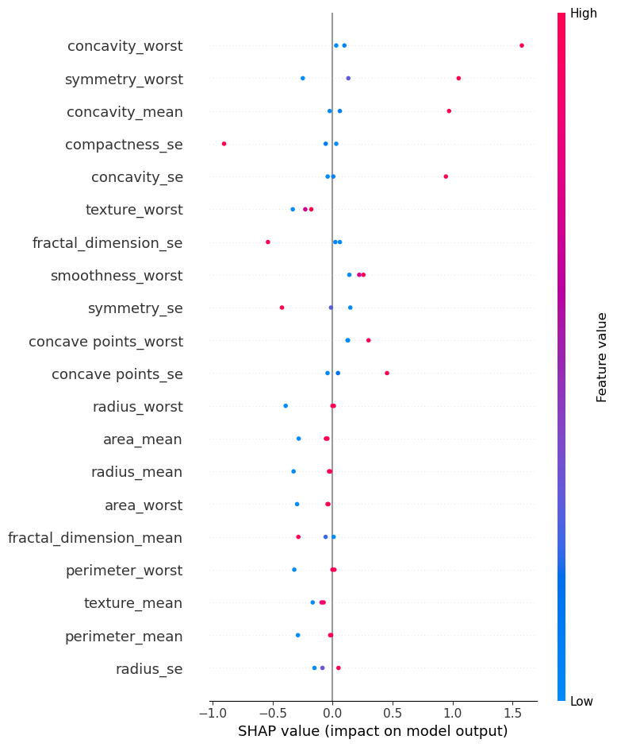
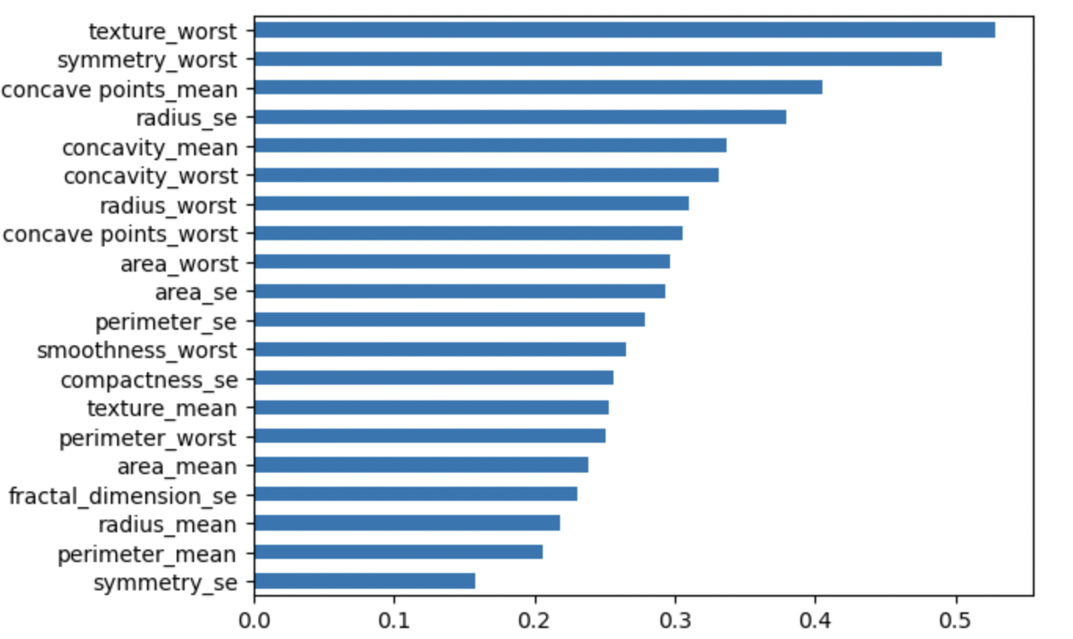
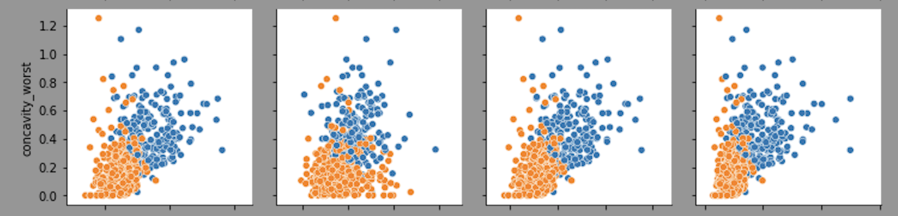
Feature Importance and Interpretability
Top 20 Features
All Test data
Incorrectly Classified Test data

Slide 8
Serialization and Parallel Training:
Trained 5 ML Model with best parameters of hyperparameter tuned models in both serial and parallel.
Serial Training and Evaluating Time: 2.59 Secs
Parallel Training and Evaluating Time: 0.00026 Sec
Serialization is 1000x time of Parallelization.

